Slide 1
Finding the centre: corrections for asymmetry in HTS datasets
Greg Gloor, Jean Macklaim, Jia Wu
U. Western Ontario
ggloor.github.io

Slide 2
Motivating example
Meta-transcriptome of vaginal microbiome
H
BV
Strongly asymmetric dataset of SEED functions
BV is a much more complex mixture of organisms than is H
Assumptions of tools not met
What is truly differential? What is invariant?

Slide 3
Back to basics
DNA or RNA fragments from the environment
A random sample used to make a library
A random sample of the library is sequenced and mapped
This generates a table of counts per feature (OTU, gene) in each sample
The number of reads is determined by the machine!
Sequencing is not counting
Gloor et al. 2016. Ann. Epidem.
Gloor et al. 2016. Can. J. Micro.
Gloor et al. 2016 Aus. J. Stats
Notes:
Many more fragments than we can count

Slide 4
Counting our things
🐯
🐞
👽
Example 100 random sample sets
range=1800-2200
range= 8000-12000
range=450-550
🐯
🐞
👽

Slide 5
Effect of fixed machine capacity
🐯
🐞
👽
Constant sum of 1000 (or any other)
Count normalization
Rarefaction
Proportion
percentage, relative abundance
RNA-seq, metagenomics, tag-sequencing
Lovell et al, 2015. PLoS Comp Bio
Gloor, et al. 2016. Ann Epidemiology
Gloor, et al. 2016. Can J. Micro

Slide 6
Only have ratio information
Count
Sequencing
Simplex
🐯
🐞
👽
27
853
66
740
112
216
X = [ x₁, x₂, … x_{D} ], g_{X} = geometric mean of X
clr(x) = [ log(x₁/g_{X}), log(x₂/g_{X}), … log(x_{D}/g_{X}) ]
Measurements now logarithms of ratios between parts
Abundance is not directly represented
Values are now unconstrained,
The clr transformation is scale invariant
Ratios are linearly related
Must delete, estimate or replace 0 values
Aitchison 1986. Stat. Anal. Comp Data
Pawlowsky-Glahn, 2015. Mod. Anal. CoDa

Slide 7
The 0 in the room
Sequencing instruments do not count
Observed count in a sample is a single estimate of the probability of observing the count given the frequency of the molecule in the sample scaled by the total counts (sequencing depth, library size) of the sample
Our approach (ALDEx2)
Generate a distribution of probabilities consistent with the data, clr transform, perform analyses and report expected values
Dramatically reduces false positives with little or no loss of sensitivity for essentially any seq’omics dataset
Still sensitive to outliers and asymmetry
Fernandes 2013 PLoS ONE
Thorsen 2016 Microbiome

Slide 8
Modelled data
Random data by polyester and Bowtie mapping to Sc genome
Include 2-5X symmetric difference (TP)
Include various amounts of asymmetric difference
Breaks assumptions of symmetric or stochastic noise in the system
The centre of the data is pushed off the midline (gm)

Slide 9
We need a better estimate of the centre
clr(x) = [ log(x₁/g_{X}), log(x₂/g_{X}), … log(x_{D}/g_{X}) ]
The denominator must be comparable in the samples
So, if asymmetric, find a common denominator
Non-zero in group A or group B (NZLR)
Median of geometric distribution (MED)
Median variance +/- IQR (IQLR)
User defined (ULR)
qPCR

Slide 10
They all work!

Slide 11
But fail in different ways and with different thresholds
NZLR best in test dataset, but requires zero value asymmetry
CLR, IQLR, median unaffected by actual value of asymmetry
No approach is ‘set it and forget it’

Slide 12
We must make some assumptions
Assume Housekeeping functions invariant
CLR: RPG 2.4x, GLY 2.5X
IQLR: RPG 1.6X, GLY 1.5X
NZLR: RPG 1.4X, GLY 1.4X
ULR: RPG 1.06X, GLY 1.1X

Slide 13
Summary
Sequencing is not counting
Cannot always add 1
Meta-transcriptomics is hard
Assumptions must be made
Some things must be constant, some things must be different
If assume housekeeping genes constant, then can treat HTS data similar in concept to qPCR
Expression = YFG / Housekeeping gene(s)
IQLR is good general purpose tool
ULR is useful for extreme cases

Slide 14

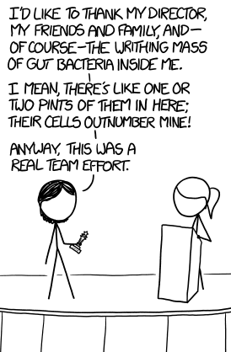

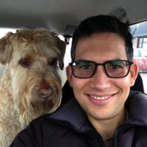
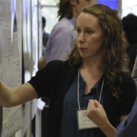



Acknowledgments
🐯
🐞
👽
Andrew
Fernandes
Jean
Macklaim
Vera Pawlowsky-Glahn
Juan Jose Egozcue
Justin Silverberg
🐯
🐞
👽
Gregor Reid
Jeremy Burton
Michael Vu
Jia Rong Wu
Agriculture and Agrifoods
Canada
Notes:
Many more fragments than we can count

